Slide 1

Sales & Reviews Performance Analysis
Key Insights from the Sales Data Analysis Dashboard

Slide 2
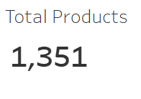
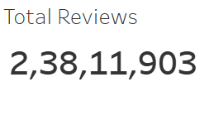
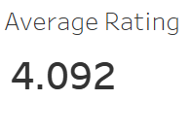
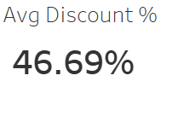
Executive Summary
Here is a high-level snapshot of current product landscape and customer feedback.
Total Products: It currently list 1,351 distinct products.
Total Reviews: It has a massive and statistically significant dataset of over 2.38 Crore customer reviews.
Average Customer Rating: Overall average product rating is a strong 4.09 out of 5.
Average Discount: Products are offered at an average discount of 46.69%.

Slide 3
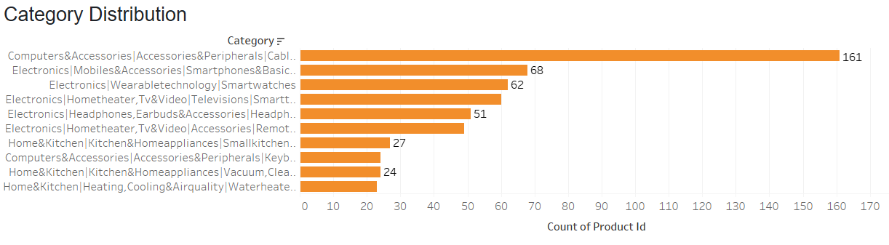
Product Portfolio Breakdown
Product count is heavily concentrated in a few key electronics and accessory categories.
The "Computers & Accessories" and "Electronics" parent categories dominate the portfolio in terms of the number of available products.
The top category by product count is "Computers & Accessories/Accessories & Peripherals/Cables & Accessories/Cables/UsbCables” (161 products).
This is followed by "Mobiles & Accessories/Smartphones & basic Mobiles/ Smartphones" (68 products) and "Wearable Technology/Smartwatches" (62 products).

Slide 4
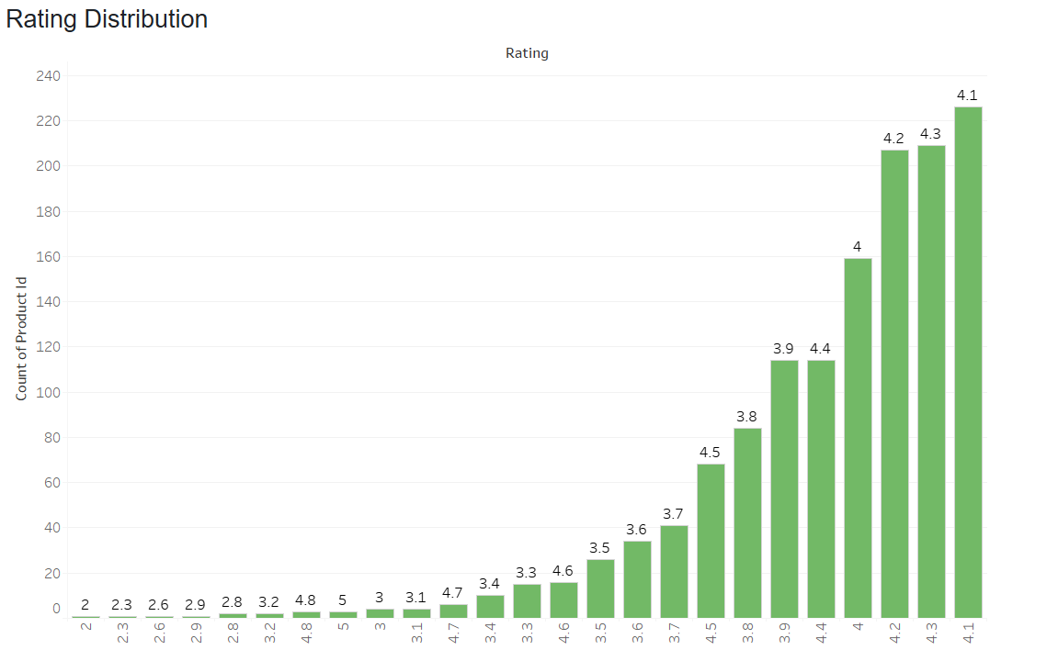
Customer Sentiment & Ratings
Customer feedback is overwhelmingly positive, with most products rated near or above our 4.09 average.
The vast majority of our products receive ratings between 3.8 and 4.5.
The most frequent ratings given to the products are 4.1, 4.2 and 4.3.
This strong concentration of high ratings indicates a healthy level of customer satisfaction across the product line.

Slide 5
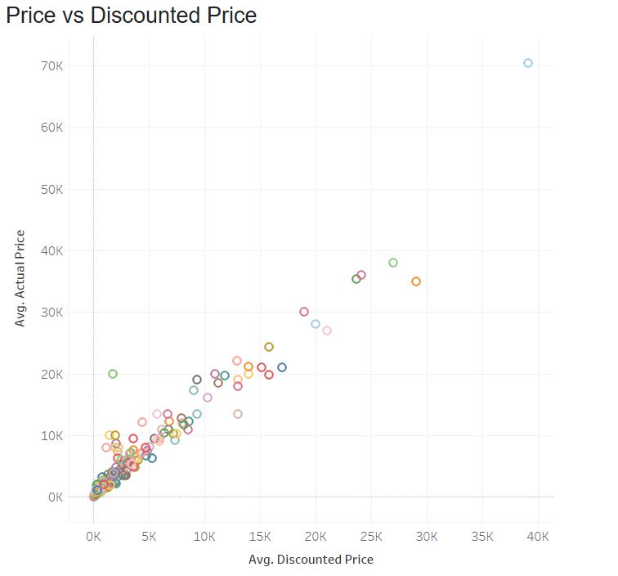
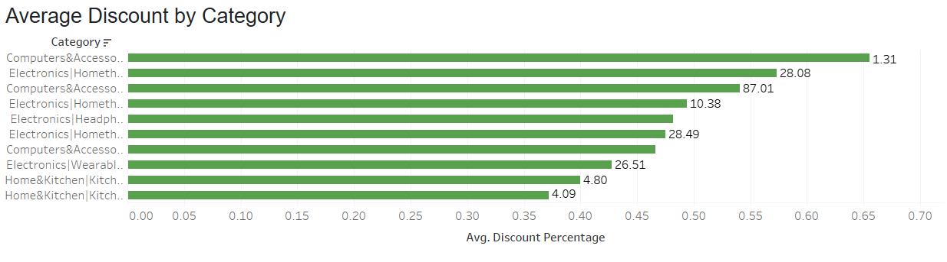
Discount Strategy
We offer big discounts, with the average being almost 47%.
The "Computers & Accessories" category gets some of the highest discounts.
The charts show how these discounts apply to different products.

Slide 6
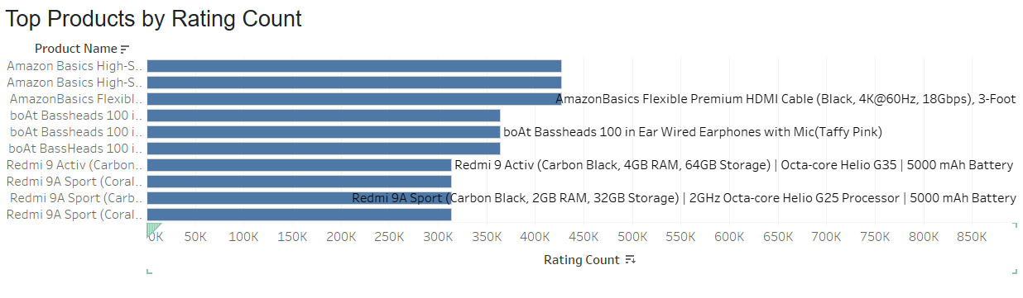
Most Popular Products
A few key products get the most customer reviews.
Brands like Amazon and Boat are the clear fan favorites.
These popular items are very important for our brand's reputation.

Slide 7
Key Lessons & the Plans
Customers are happy: Our average rating is high at 4.09. We should use this good feedback in our advertising.
Discounts are very high: We need to check if our 47% average discount is helping us earn more profit or just lowering prices.
We have star products: Let's figure out why items from Boat and Amazon Basics are so successful and use that knowledge to improve our other products.

Slide 8
THANK YOU
Submitted by: Mohammad Bilal Ansari Date: September 25, 2025

